Slide 1

Tutorial 10 - Camera Calibration & Epipolar Geometry

Slide 2
Agenda
Camera Model
Camera Calibration
Estimating M
Chessboard Demo
Homography Quiz
Epipolar Geometry
Essential Matrix
Fundamental Matrix
Fundamental Demo

Slide 3
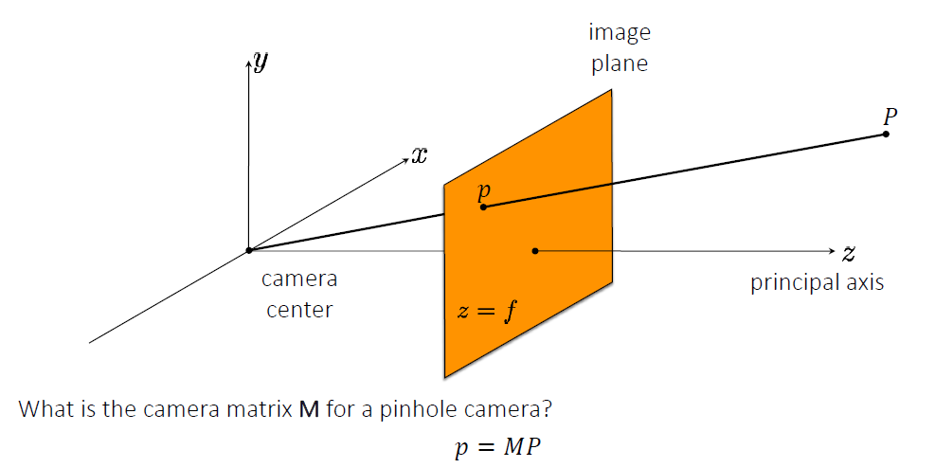
Camera Model
The (rearranged) pinhole camera
A 3D world point 𝑃is projected by the camera matrix 𝑀 to the 2D image point 𝑝

Slide 4
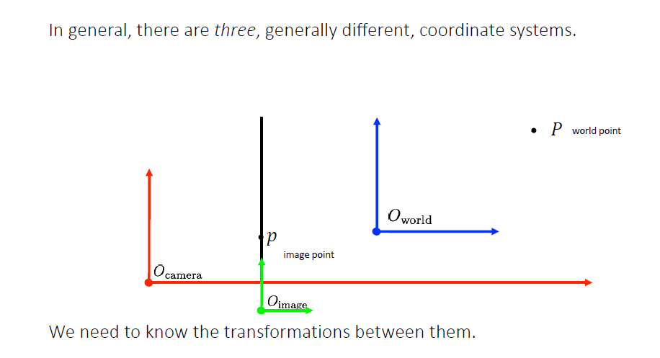
Camera Model
$M$ is a 3×4 matrix comprised of two sets of parameters: Intrinsic and Extrinsic. What is the decomposed structure of $M$?

Slide 5
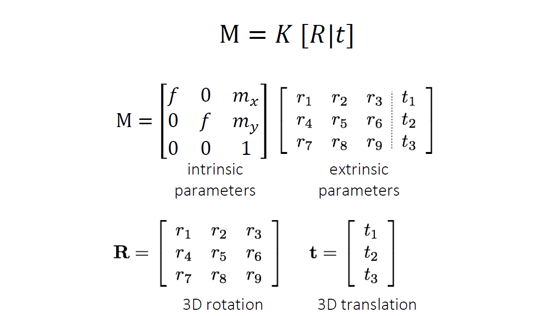
Camera Model
$M$ is a 3×4 matrix comprised of two sets of parameters: Intrinsic and Extrinsic. What is the decomposed structure of $M$?

Slide 6
Camera Model
How many degress of freedom so far?
And after switching $f$ with $f_{x}$ and $f_{y}$ and adding skew 𝑠?

Slide 7
Camera Calibration
Estimation of $M$
Separating Extrinsic and Intrinsic Parameters

Slide 8
Geometric Camera Calibration: Estimating 𝑀
Given a set of matched points $\{P_{i},p_{i}\}$, we want to estimate $M$
Use the camera model:$P_{i}=Mp_{i}$
Where did we get such matched points?
Same trick as in the Homography tutorial → switch to row-wise representation of the unknowns: $\left[\begin{aligned}x \\ y \\ w\end{aligned}\right]=\left[\begin{matrix}- & m_{1}^{T} & - \\ - & m_{2}^{T} & - \\ - & m_{3}^{T} & -\end{matrix}\right]P$

Slide 9

Estimating $M$
Resulting equation for $x$ and $y$ in heterogeneous coordinates: $\overset{˜}{x}=\frac{m_{1}^{T}P}{m_{3}^{T}P},\overset{˜}{y}=\frac{m_{2}^{T}P}{m_{3}^{T}P}$
Rearranging to solve for $m_{i}$: $m_{1}^{T}P-\overset{˜}{x}m_{3}^{T}P=0$ $m_{2}^{T}P-\overset{˜}{y}m_{3}^{T}P=0$
What is the dimension of $m_{i}^{T}P$

Slide 10
Estimating $M$
Rearrange into a matrix for $N_{p}$ points:
$$\left[\begin{matrix}P_{i}^{T} & 0^{T} & -{\overset{˜}{x}}_{i}P_{i}^{T} \\ 0^{T} & P_{i}^{T} & -{\overset{˜}{y}}_{i}P_{i}^{T} \\ . & . & . \\ . & . & . \\ P_{N_{p}}^{T} & 0^{T} & -{\overset{˜}{x}}_{N_{p}}P_{N_{p}}^{T} \\ 0^{T} & P_{N_{p}}^{T} & -{\overset{˜}{y}}_{N_{p}}P_{N_{p}}^{T}\end{matrix}\right]\left[\begin{aligned}| \\ m_{1} \\ | \\ m_{2} \\ | \\ m_{3} \\ |\end{aligned}\right]=\left[\begin{aligned}0 \\ 0 \\ . \\ . \\ 0 \\ 0\end{aligned}\right]↔Am=0$$
What are the dimensions? How much points $N_{p}$ do we need?

Slide 11
Estimating $M$
boils down to the problem:
$\overset{̂}{m}=\text{arg}\min_{m}∥Am∥^{2}s.t.∥m∥^{2}=1$
Solution via SVD of $A=UΣV^{T}$:
$\overset{̂}{m}$ is the column of V corresponding to the smallest eigen-value.
How about separating $M$ to $K\left[R|t\right]$?

Slide 12
Decomposition of M to K, R & t
rewrite $M$:
$M=K\left[R|t\right]=K\left[R|-Rc\right]=\left[N|-Nc\right]$
$c$ can be found via SVD of $M$ due to the relation:
$Mc=0$
Then $N$ can be further decomposed into $N=KR$:
How? using QR decomposition because $K$ is upper triangular and $R$ is orthogonal
However..
Does not take into account noise, radial distortions, hard to impose prior knowledge (e.g. $f$), etc.
Solution?

Slide 13
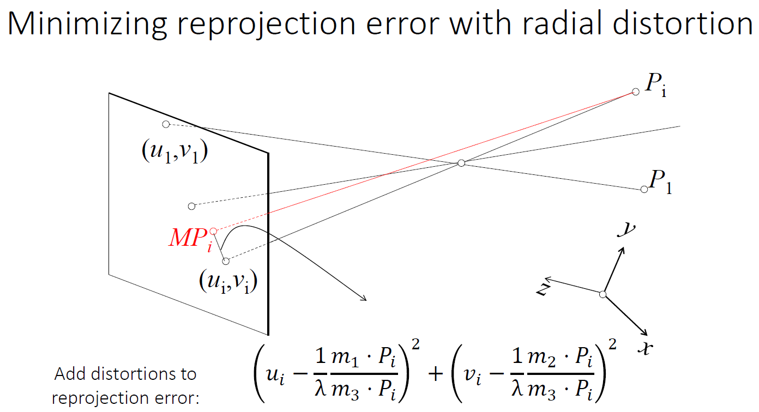
Minimize reprojection error
Where the radial distortion model is: $λ=1+k_{1}r^{2}+k_{2}r^{4}+k_{3}r^{6}$

Slide 14
Minimize reprojection error
Radial distortion is multiplicative:
$x_{rad}=x\left[1+k_{1}r^{2}+k_{2}r^{4}+k_{3}r^{6}\right]$
$y_{rad}=y\left[1+k_{1}r^{2}+k_{2}r^{4}+k_{3}r^{6}\right]$
Usually we also include tangential distortion:
$x_{tan}=x+\left[2p_{1}xy+p_{2}\left(r^{2}+2x^{2}\right)\right]$
$y_{tan}=y+\left[p_{1}\left(r^{2}+2y^{2}\right)+2p_{2}xy\right]$
We end up with 5 parameters to estimate:
$\text{distortion coefficients}={\left[k_{1},k_{2},k_{3},p_{1},p_{2}\right]}^{T}$

Slide 15
Chessboard Calibration in OpenCV
Take a notebook and paste a chesspattern
Capture this pattern from several angles and positions
Calibrate using OpenCV

Slide 16
Chessboard Calibration in OpenCV
Getting the 3D to 2D points correspondences from a known planar object
Chessboard has fixed distances between squares known apriori
Camera static and chessboard moves $↔$ chessboard static and camera moves
Camera moves $↔$ Extrinsic parameters in each frame change
Therefore we got the matches of real world points and camera points ${\left\{P_{i},p_{i}\right\}}_{I=1}^{N}$!
$P_{i}=\left[X_{i},Y_{i},Z_{i}=0\right]$, where, $X_{i},Y_{i}$ set by periodicity of the chessbaord
$p_{i}=\left[x_{i},y_{i}\right]$, detected corners in the image

Slide 17
Homography Quiz
Quiz 1
Prove that a $3×3$ homography transform H is sufficient to describe the mapping between a planar 3D object and a camera, i.e. point matches of the form $\left\{p_{i},P_{i}\right\}$, where $p_{i}={\left[x_{i},y_{i},w_{i}\right]}^{T}$ and $P_{i}={\left[X_{i},Y_{i},Z_{i},1\right]}^{T}$ satisfying $aX_{i}+bY_{i}+cZ_{i}+d=0$.

Slide 18

Homography Quiz
Quiz 1
In this special case of a planar scene, we do not need the full $3×4$ camera matrix $M$, and we can make due with a $3×3$ homography matrix $H$. The proof is relatively straight forward, and rely on the following observation:
Since the points in 3D lie on a plane: $aX+bY+cZ+d=0$
we can switch sides and write down the plane equation for $Z$, such that $P_{i}={\left[X_{i},Y_{i},-\frac{a}{c}X_{i}-\frac{b}{c}Y_{i}-\frac{d}{c},1\right]}^{T}$.

Slide 19
Homography Quiz
Quiz 1
This leads to the main conclusion that the 4D homogeneous coordinates are redundant and can be written down by a 3D homogeneous coordinates:
$\left[\begin{aligned}X_{i} \\ Y_{i} \\ Z_{i}\end{aligned}\right]=\left[\begin{matrix}1 & 0 & 0 \\ 0 & 1 & 0 \\ -\frac{a}{c} & -\frac{b}{c} & -\frac{d}{c}\end{matrix}\right]\left[\begin{aligned}X_{i} \\ Y_{i} \\ 1\end{aligned}\right]$

Slide 20
Homography Quiz
Quiz 1
Now coming back to the general camera matrix $M$ how can we conclude it can be reduced to a homography?
The answer lies in simplifying the matrix-vector product.

Slide 21
Homography Quiz
Quiz 1
A general $M$ satisfy the relation:
$$\left[\begin{aligned}x_{i} \\ y_{i} \\ w_{i}\end{aligned}\right]=\left[\begin{matrix}m_{11} & m_{12} & m_{13} & m_{14} \\ m_{21} & m_{22} & m_{23} & m_{24} \\ m_{31} & m_{32} & m_{33} & m_{34}\end{matrix}\right]\left[\begin{aligned}X_{i} \\ Y_{i} \\ Z_{i} \\ 1\end{aligned}\right]$$
Assuming the scene is planar, we plug in the plane equation for $Z_{i}=-\frac{a}{c}X_{i}-\frac{b}{c}Y_{i}-\frac{d}{c}$:
$$\left[\begin{aligned}x_{i} \\ y_{i} \\ w_{i}\end{aligned}\right]=\left[\begin{matrix}m_{11} & m_{12} & m_{13} & m_{14} \\ m_{21} & m_{22} & m_{23} & m_{24} \\ m_{31} & m_{32} & m_{33} & m_{34}\end{matrix}\right]\left[\begin{aligned}X_{i} \\ Y_{i} \\ -\frac{a}{c}X_{i}-\frac{b}{c}Y_{i}-\frac{d}{c} \\ 1\end{aligned}\right]$$

Slide 22
Homography Quiz
Quiz 1
Now, let us look more closely at the formula for $x_{i}$:
$$x_{i}=m_{11}X_{i}+m_{12}Y_{i}+m_{13}\left(-\frac{a}{c}X_{i}-\frac{b}{c}Y_{i}-\frac{d}{c}\right)+m_{14}$$
The terms can be rearranged and written as:
$$x_{i}=\left(m_{11}-\frac{a}{c}m_{13}\right)X_{i}+\left(m_{12}-\frac{b}{c}m_{13}\right)Y_{i}+\left(m_{14}-m_{13}\frac{d}{c}\right)$$

Slide 23
Homography Quiz
Quiz 1
Similarly, this can be done for $y_{i}$ and $w_{i}$:
$$y_{i}=\left(m_{21}-\frac{a}{c}m_{23}\right)X_{i}+\left(m_{22}-\frac{b}{c}m_{23}\right)Y_{i}+\left(m_{24}-m_{23}\frac{d}{c}\right)$$
$$w_{i}=\left(m_{31}-\frac{a}{c}m_{33}\right)X_{i}+\left(m_{32}-\frac{b}{c}m_{33}\right)Y_{i}+\left(m_{34}-m_{33}\frac{d}{c}\right)$$

Slide 24
Homography Quiz
Quiz 1
Therefore, rewriting this in matrix form we get the following relation:
$$\left[\begin{aligned}x_{i} \\ y_{i} \\ w_{i}\end{aligned}\right]=\left[\begin{matrix}m_{11}-\frac{a}{c}m_{13} & m_{12}-\frac{b}{c}m_{13} & m_{14}-\frac{d}{c}m_{13} \\ m_{21}-\frac{a}{c}m_{23} & m_{22}-\frac{b}{c}m_{23} & m_{24}-\frac{d}{c}m_{23} \\ m_{31}-\frac{a}{c}m_{33} & m_{32}-\frac{b}{c}m_{33} & m_{34}-\frac{d}{c}m_{33}\end{matrix}\right]\left[\begin{aligned}X_{i} \\ Y_{i} \\ 1\end{aligned}\right]$$
Meaning, the 3D point $P_{i}$ can be indeed reduced to a 3D homogeneous vector ${\left[X_{i},Y_{i},1\right]}^{T}$, and is related to the 2D point in the image $p_{i}=\left[x_{i},y_{i},w_{i}\right]$ through a $3×3$ homography $H$ that is a function of the entries in the general $3×4$ camera matrix $M$, and the normal to the plane ${\left[a,b,c,d\right]}^{T}$.

Slide 25
Homography Quiz
Quiz 2
Prove that there exists a homography $H$ that satisfies:
$p_{1}≡Hp_{2}$between the 2D points (in homogeneous coordinates) $p_{1}$ and $p_{2}$ in the images of a plane $P_{i}$ captured by two $3×4$ camera projection matrices $M_{1}$ and $M_{2}$, respectively.
The symbol $≡$ stands for equality up to scale.
(Note: A degenerate case happens when the plan $Π$ contains both cameras' centers, in which case there are infinite choices of $H$ satisfying the equation. You can ignore this special case in your answer.)

Slide 26
Homography Quiz
Quiz 2
Plane in 3D using homogeneous coordinates is given by:
$n^{T}P=0$ Where $n,P$ are homogeneous vectors (4 numbers each) and $n$ is the normal to the plane.
Therefore, we can find a basis of 3 vectors $u_{1},u_{2},u_{3}$ in $R$, such that each point on the plane is given by:
$$P=\overset{3}{\underset{i=1}{∑}}α_{i}u_{i}$$
The projection of 3D point $P$ to the $j^{th}$ image point $p_{j}$ is given by:
$$p_{j}=M_{j}P=\overset{3}{\underset{i=1}{∑}}α_{i}M_{j}u_{i}$$

Slide 27
Homography Quiz
Quiz 2
If we denote $v_{j}^{i}=M_{j}u_{i}$ we get:
$$p_{1}=\overset{3}{\underset{i=1}{∑}}α_{i}v_{1}^{i}$$
$$p_{2}=\overset{3}{\underset{i=1}{∑}}α_{i}v_{2}^{i}$$
Hence, the relation between the two points is a $3×3$ matrix satisfying:
$$\left[\begin{matrix}| & | & | \\ v_{1}^{1} & v_{1}^{2} & v_{1}^{3} \\ | & | & |\end{matrix}\right]=\left[\begin{matrix}* & * & * \\ * & * & * \\ * & * & *\end{matrix}\right]\left[\begin{matrix}| & | & | \\ v_{2}^{1} & v_{2}^{2} & v_{2}^{3} \\ | & | & |\end{matrix}\right]$$

Slide 28
Homography Quiz
Quiz 2
Relation to camera
Recall that we have 11 degrees of freedom in $M$
If all the calibration points are on a plane, we get at most 8 independent equations out of 4
Any $5^{\text{th}}$ point will result in constraints that are linearly dependent on the constraints from the previous 4 pts on the
Therefore, in estimating $M$ we can't rely on a single image of the chessboard.

Slide 29
Homography Quiz
Quiz 3
Prove that there exists a homography $H$ that satisfies the equation $p_{1}=Hp_{2}$, given two cameras separated by a pure rotation. That is, for camera 1, $p_{1}=K_{1}\left[I|0\right]P$, and for camera 2, $p_{2}=K_{2}\left[R|0\right]P$. Note that $K_{1}$ and $K_{2}$ are the $3×3$ intrinsic matrices of the cameras and are different. $I$ is $3×3$ identity matrix, $0$ is a $3×1$ zero vector and $P$ is a point in 3D space. $R$ is the $3×3$ rotation matrix of the camera.

Slide 30
Homography Quiz
Quiz 3
Since the last column is zero, we can see that:
$$\left[\begin{aligned}X \\ Y \\ Z\end{aligned}\right]=R^{-1}K_{2}^{-1}p_{2}$$
Substituting this in the second equation we get:
$$p_{1}=K_{1}R^{-1}K_{2}^{-1}p_{2}$$
Therefore, the resulting homography is given by:
$$H=K_{1}R^{-1}K_{2}^{-1}$$

Slide 31
Homography Quiz
Quiz 3
Take away is 2 cameras differing only in rotation can't triangulate!
Remember where this was useful?
Panorama stitching! (There we did not care about recovering depth)

Slide 32
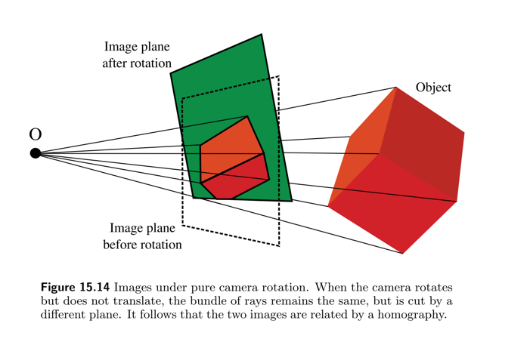
Homography Quiz
Quiz 3

Slide 33
Homography Quiz
Quiz 4
Suppose that a camera is rotating about its center $C$, keeping the intrinsic parameters $K$ constant. Let $H$ be the homography that maps the view from one camera orientation to the view at a second orientation. Let $θ$ be the angle of rotation between the two. Show that $H^{2}$ is the homography corresponding to a rotation of $2θ$.

Slide 34
Homography Quiz
Quiz 4
We have just shown that for such a scenario:
$$H_{2→1}=K_{1}R_{θ}^{-1}K_{2}^{-1}$$
$$H_{1→2}=K_{2}R_{θ}K_{1}^{-1}$$
Applying the constraint $K_{1}=K_{2}≡K$ gets us:
$$H_{1→2}=KR_{θ}K^{-1}$$
Applying $H_{1→2}$ twice gets us:
$$H_{1→2}^{2}=KR_{θ}K^{-1}KR_{θ}K^{-1}=KR_{θ}R_{θ}K^{-1}$$
Since $R_{θ}R_{θ}=R_{2θ}$, we indeed get:
$$H_{1→2}^{2}=KR_{2θ}K^{-1}$$
Which is a homography that corresponds to a rotation of $2θ$.

Slide 35
Homography Quiz
Quiz 5
Prove that points on a single line do not uniquely constrain the homography $H$. In other words, prove that we need points on at least 2 different directions within the plane to estimate a homography reliably.

Slide 36
Homography Quiz
Quiz 5
If all points lie on a line there is a $3×1$ vector $l$ such the $l^{T}p=0$ for all points $p$.
Now suppose you found a homography matrix $H$ such that $p_{j}^{′}=Hp_{j}$, and yet all your points satisfy $l^{T}p_{j}=0$.
Then it is easy to see that for every $3×1$ vector $v$ the matrix $H^{′}=H+vl^{T}$ will also satisfy $p_{j}^{′}=H^{′}p_{j}$
* This implies that there is no unique $H$ which explains points on the same line.

Slide 37

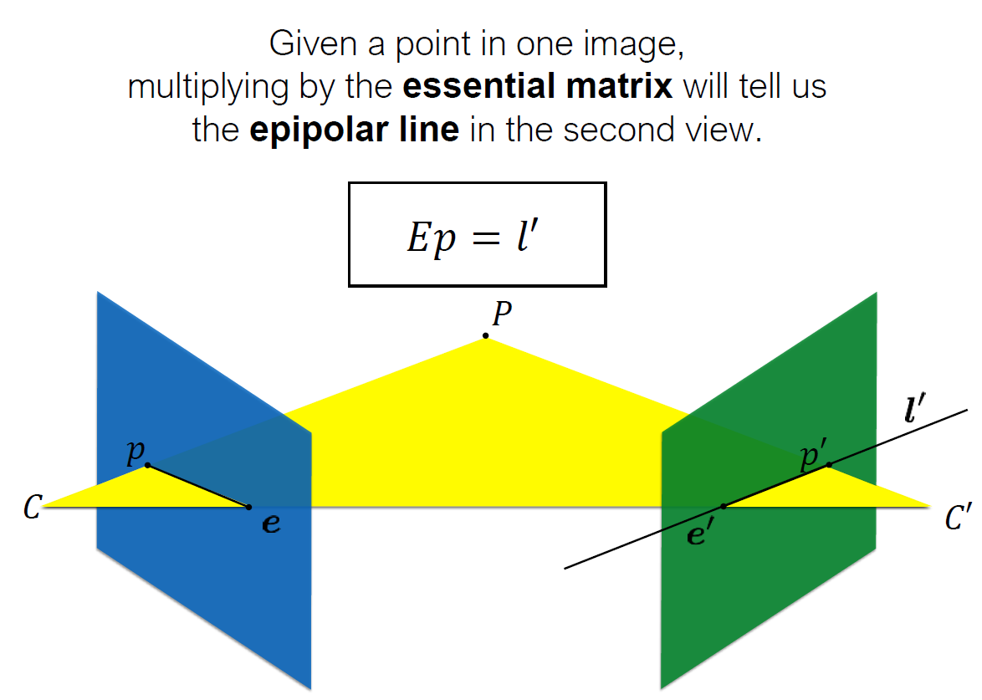
Epipolar Geometry
Epipolar Lingo

Slide 38
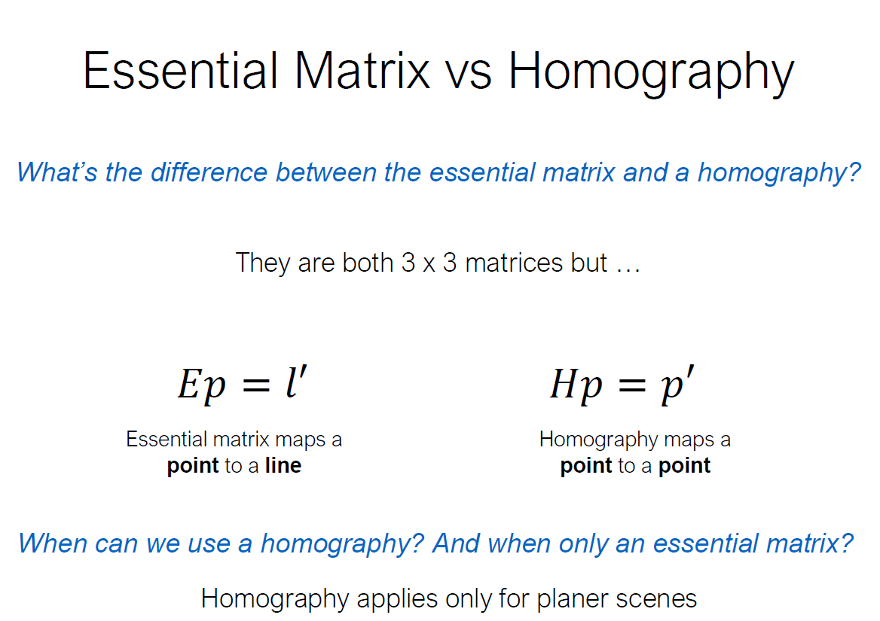
Epipolar Geometry
Epipolar Lingo

Slide 39
Epipolar Geometry
Epipolar Lingo
Given by the equation $p^{′T}Ep=0$
and also equals $E=R[dC]_{×},E=[t]_{×}R$, where $t=-RdC$
Properties:
$p^{′T}Ep=0$
$$p^{T}l=0,p^{′T}l^{′}=0$$
$$l^{′}=Ep,l=E^{T}p^{′}$$
$$e^{′T}E=0,Ee=0$$

Slide 40

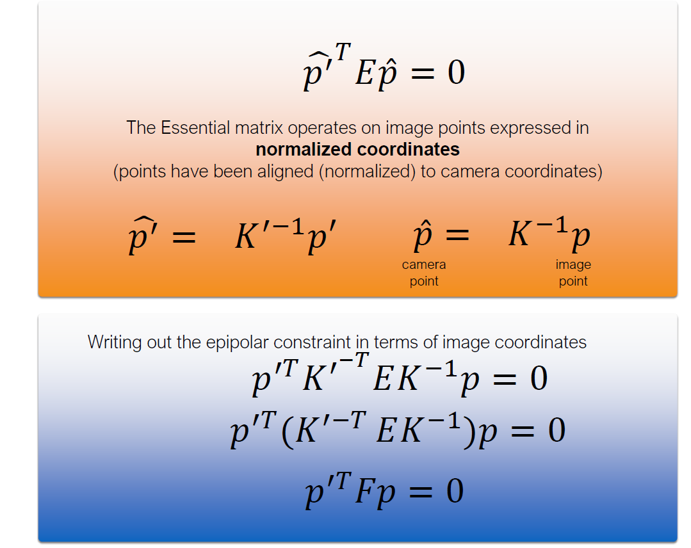
Fundamental Matrix

Slide 41
The Fundamental matrix
SolutionFrom Spring 2019 Q4
Explain how you can calculate $F$ from the known $K$, $R$, and $t$ of the camera.

Slide 42
The Fundamental matrix
SolutionFrom Spring 2019 Q4 Solution
$$F≜K^{-T}EK^{′-1}$$
$$E=[t]_{×}R$$
$$F=K^{-T}[t]_{×}RK^{′-1}$$
where, $[t]_{×}=\left[\begin{matrix}0 & -t_{z} & t_{y} \\ t_{z} & 0 & -t_{x} \\ -t_{y} & t_{x} & 0\end{matrix}\right]$

Slide 43
Fundamental Matrix Properties
Properties
$$p^{′T}Fp=0$$
$$p^{T}l=0,p^{′T}l^{′}=0$$
$$l^{′}=Fp,l=F^{T}p^{′}$$
$$e^{′T}F=0,Fe=0$$

Slide 44
The Fundamental matrix
(From Spring 2019 Q4)
Explain shortly the steps of the algorithm for estimating $F$ (when $K,R,t$ are unknown). How many DOF does $F$ have? How many sets of points are needed to find it?

Slide 45
The Fundamental matrix
(From Spring 2019 Q4) Solution
Assume we are given 2D to 2D M matched image points:
$${\left\{p_{i},p_{i}^{′}\right\}}_{i=1}^{M}$$
Each correspondence should satisfy:
$$p_{i}^{T}Fp_{i}^{′}=0↔{\left[\begin{matrix}x_{i} & y_{i} & 1\end{matrix}\right]}^{T}\left[\begin{matrix}f_{1} & f_{2} & f_{3} \\ f_{4} & f_{5} & f_{6} \\ f_{7} & f_{8} & f_{9}\end{matrix}\right]\left[\begin{aligned}x_{i}^{′} \\ y_{i}^{′} \\ 1\end{aligned}\right]=0$$
How to solve?
The 8-point algorithm $↔$ arrange into homogeneous linear equations and SVD..

Slide 46
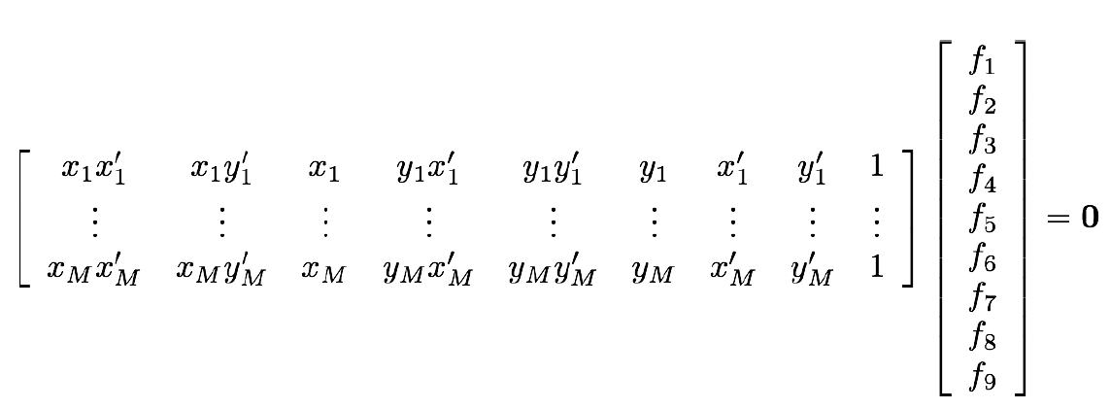
The Fundamental matrix
(From Spring 2019 Q4) Solution
8 DOF, solve SVD under the constraint $||f||=1$

Slide 47
The Fundamental matrix
From Spring 2019 Q4 Solution
Under what conditions does $F=E$?
Since $F≜{K^{′}}^{-T}EK^{-1}$, when $K^{′}=K=I$ we'll get $F=I^{-1}EI^{-1}=E$
note that $F=K^{′}EK$, that's a hint that we want to constraint K and K'

Slide 48
The Fundamental matrix
From Spring 2019 Q4
Suppose we know that the camera planes are parallel (after rectification - i.e. they are only translated on the x axis). Does that information allow us to use less sets of matching points to find $F$?

Slide 49
The Fundamental matrix
From Spring 2019 Q4
The camera matrices are given by $M=K[I|0]$ and $M^{′}=K^{′}[R|t]$, where $K=\left[\begin{matrix}f & 0 & 0 \\ 0 & f & 0 \\ 0 & 0 & 1\end{matrix}\right],K^{′}=\left[\begin{matrix}f^{′} & 0 & 0 \\ 0 & f^{′} & 0 \\ 0 & 0 & 1\end{matrix}\right],R=I,t=\left[\begin{aligned}t_{x} \\ 0 \\ 0\end{aligned}\right]$

Slide 50
The Fundamental matrix
From Spring 2019 Q4
We know that $F={K^{′}}^{-T}[t]_{×}RK^{-1}$, so by plugging in the relevant parameters:
$$F=\left[\begin{matrix}1/f^{′} & 0 & 0 \\ 0 & 1/f^{′} & 0 \\ 0 & 0 & 1\end{matrix}\right]\left[\begin{matrix}0 & 0 & 0 \\ 0 & 0 & -t_{x} \\ 0 & t_{x} & 0\end{matrix}\right]\left[\begin{matrix}1/f & 0 & 0 \\ 0 & 1/f & 0 \\ 0 & 0 & 1\end{matrix}\right]$$
$$F=\left[\begin{matrix}0 & 0 & 0 \\ 0 & 0 & -t_{x}/f^{′} \\ 0 & -t_{x}/f & 0\end{matrix}\right]$$

Slide 51
The Fundamental matrix
From Spring 2019 Q4
$F$ now has only 2 DoFs, so we only need 2 points.
Note that Even if we look at more complex intrinsic matrices, and 3 degrees of translation, we can still spare 3 DoFs (and 3 points) by not having a rotation matrix!

Slide 52

Questions?

